Slide 1
UNIT 4
Relational ALGEBRA
Structure of Relational Databases
Relational Algebra
Tuple Relational Calculus
Domain Relational Calculus
Extended Relational-Algebra-Operations
Modification of the Database
Views

Slide 2

Example of a Relation

Slide 3
Basic Structure
Formally, given sets D₁, D₂, …. D_{n} a relation r is a subset of
D₁ x D₂ x … x D_{n}
Thus a relation is a set of n-tuples (a₁, a₂, …, a_{n}) where
each a_{i} ∈ D_{i}
Example: if
customer-name = {Jones, Smith, Curry, Lindsay}
customer-street = {Main, North, Park}
customer-city = {Harrison, Rye, Pittsfield}
Then r = { (Jones, Main, Harrison),
(Smith, North, Rye),
(Curry, North, Rye),
(Lindsay, Park, Pittsfield)}
is a relation over customer-name x customer-street x customer-city

Slide 4
Attribute Types
Each attribute of a relation has a name
The set of allowed values for each attribute is called the domain of the attribute
Attribute values are (normally) required to be atomic, that is, indivisible
  E.g. multivalued attribute values are not atomic
  E.g. composite attribute values are not atomic
The special value null is a member of every domain
The null value causes complications in the definition of many operations
  we shall ignore the effect of null values in our main presentation and consider their effect later

Slide 5
Relation Schema
A₁, A₂, …, A_{n} are attributes
R = (A₁, A₂, …, A_{n} ) is a relation schema
E.g. Customer-schema =
(customer-name, customer-street, customer-city)
r(R) is a relation on the relation schema R
E.g. customer (Customer-schema)

Slide 6
Relation Instance
The current values (relation instance) of a relation are specified by a table
An element t of r is a tuple, represented by a row in a table
attributes
(or columns)
customer-name
customer-street
customer-city
Jones
Smith
Curry
Lindsay
Main
North
North
Park
Harrison
Rye
Rye
Pittsfield
tuples
(or rows)
customer

Slide 7
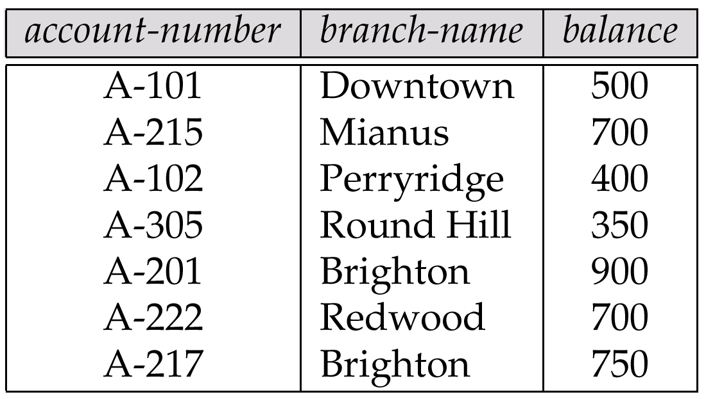
Relations are Unordered
Order of tuples is irrelevant (tuples may be stored in an arbitrary order)
E.g. account relation with unordered tuples

Slide 8
Database
A database consists of multiple relations
Information about an enterprise is broken up into parts, with each relation storing one part of the information
E.g.: account : stores information about accounts
depositor : stores information about which customer
owns which account
customer : stores information about customers
Storing all information as a single relation such as
bank(account-number, balance, customer-name, ..)
results in
  repetition of information (e.g. two customers own an account)
  the need for null values (e.g. represent a customer without an account)
Normalization theory (Chapter 7) deals with how to design relational schemas

Slide 9

The customer Relation

Slide 10

The depositor Relation

Slide 11
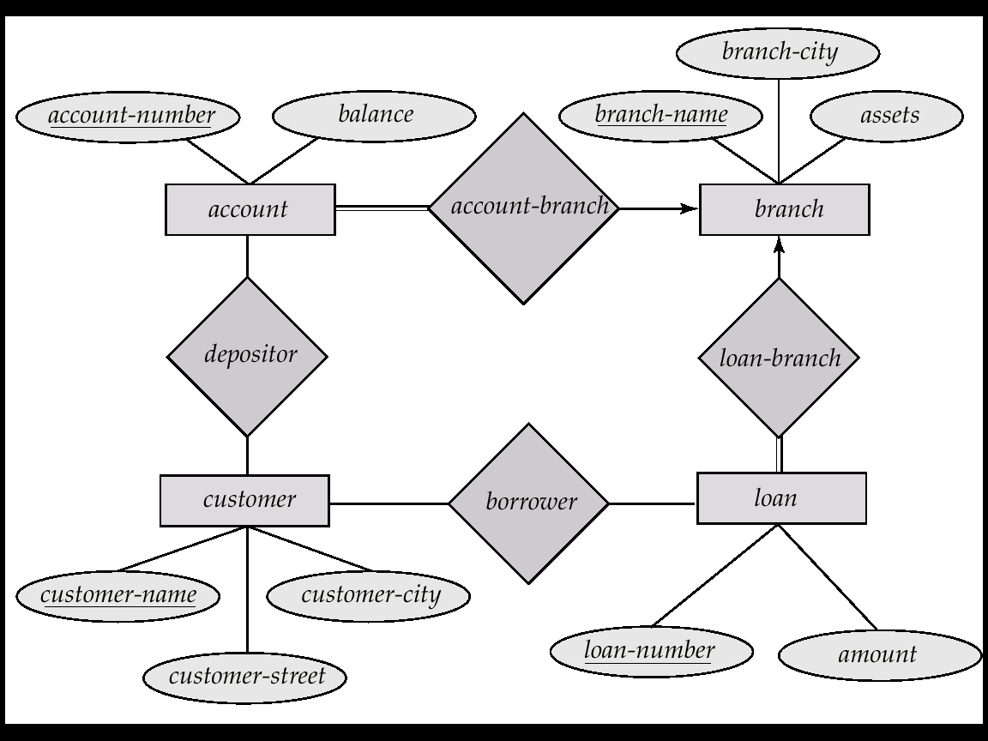
E-R Diagram for the Banking Enterprise

Slide 12
Keys
Let K ⊆ R
K is a superkey of R if values for K are sufficient to identify a unique tuple of each possible relation r(R)
  by “possible r” we mean a relation r that could exist in the enterprise we are modeling.
  Example: {customer-name, customer-street} and
  {customer-name}
  are both superkeys of Customer, if no two customers can possibly have the same name.
K is a candidate key if K is minimal
Example: {customer-name} is a candidate key for Customer, since it is a superkey (assuming no two customers can possibly have the same name), and no subset of it is a superkey.

Slide 13
Determining Keys from E-R Sets
Strong entity set. The primary key of the entity set becomes the primary key of the relation.
Weak entity set. The primary key of the relation consists of the union of the primary key of the strong entity set and the discriminator of the weak entity set.
Relationship set. The union of the primary keys of the related entity sets becomes a super key of the relation.
  For binary many-to-one relationship sets, the primary key of the “many” entity set becomes the relation’s primary key.
  For one-to-one relationship sets, the relation’s primary key can be that of either entity set.
  For many-to-many relationship sets, the union of the primary keys becomes the relation’s primary key

Slide 14

Schema Diagram for the Banking Enterprise

Slide 15
Query Languages
Language in which user requests information from the database.
Categories of languages
  procedural
  non-procedural
“Pure” languages:
  Relational Algebra
  Tuple Relational Calculus
  Domain Relational Calculus
Pure languages form underlying basis of query languages that people use.

Slide 16
Relational Algebra
Procedural language
Six basic operators
  select
  project
  union
  set difference
  Cartesian product
  rename
The operators take one or more relations as inputs and give a new relation as a result.

Slide 17
Select Operation – Example
Relation r
A
B
C
D








1
5
12
23
7
4
3
10
_{A= D > 5} (r)
A
B
C
D




1
23
7
10

Slide 18
Select Operation
Notation: σ _{p}(r)
p is called the selection predicate
Defined as:
σ_{p}(r) = {t | t ∈ r and p(t)}
Where p is a formula in propositional calculus consisting of terms connected by : ∧ (and), ∨ (or), ¬ (not)
Each term is one of:
<attribute> op <attribute> or <constant>
where op is one of: =, ≠, >, ≥. <. ≤
Example of selection:
σ _{branch-name=“Perryridge”}(account)

Slide 19
Project Operation – Example
A
B
C
Relation r:




10
20
30
40
1
1
1
2
A
C
A
C
_{A,C} (r)




1
1
1
2



1
1
2
=

Slide 20
Project Operation
Notation:
∏_{A1, A2, …, Ak} (r)
where A₁, A₂ are attribute names and r is a relation name.
The result is defined as the relation of k columns obtained by erasing the columns that are not listed
Duplicate rows removed from result, since relations are sets
E.g. To eliminate the branch-name attribute of account
∏_{account-number, balance} (account)

Slide 21
Union Operation – Example
Relations r, s:
A
B
A
B



1
2
1


2
3
s
r
r  s:
A
B




1
2
1
3

Slide 22
Union Operation
Notation: r ∪ s
Defined as:
r ∪ s = {t | t ∈ r or t ∈ s}
For r ∪ s to be valid.
1. r, s must have the same arity (same number of attributes)
2. The attribute domains must be compatible (e.g., 2nd column
of r deals with the same type of values as does the 2nd
column of s)
E.g. to find all customers with either an account or a loan
∏_{customer-name} (depositor) ∪ ∏_{customer-name} (borrower)

Slide 23
Set Difference Operation – Example
Relations r, s:
A
B
A
B



1
2
1


2
3
s
r
r – s:
A
B


1
1

Slide 24
Set Difference Operation
Notation r – s
Defined as:
r – s = {t | t ∈ r and t ∉ s}
Set differences must be taken between compatible relations.
  r and s must have the same arity
  attribute domains of r and s must be compatible

Slide 25
Cartesian-Product Operation-Example
A
B
C
D
E
Relations r, s:


1
2




10
10
20
10
a
a
b
b
r
s
r x s:
A
B
C
D
E








1
1
1
1
2
2
2
2








10
10
20
10
10
10
20
10
a
a
b
b
a
a
b
b

Slide 26
Cartesian-Product Operation
Notation r x s
Defined as:
r x s = {t q | t ∈ r and q ∈ s}
Assume that attributes of r(R) and s(S) are disjoint. (That is,
R ∩ S = ∅).
If attributes of r(R) and s(S) are not disjoint, then renaming must be used.

Slide 27
Composition of Operations
Can build expressions using multiple operations
Example: σ_{A=C}(r x s)
r x s
σ_{A=C}(r x s)
A
B
C
D
E








1
1
1
1
2
2
2
2








10
10
20
10
10
10
20
10
a
a
b
b
a
a
b
b
A
B
C
D
E



1
2
2



10
20
20
a
a
b

Slide 28
Rename Operation
Allows us to name, and therefore to refer to, the results of relational-algebra expressions.
Allows us to refer to a relation by more than one name.
Example:
ρ _{x} (E)
returns the expression E under the name X
If a relational-algebra expression E has arity n, then
ρ_{x} _{(A1, A2, …, An)} (E)
returns the result of expression E under the name X, and with the
attributes renamed to A1, A2, …., An.

Slide 29
Banking Example
branch (branch-name, branch-city, assets)
customer (customer-name, customer-street, customer-only)
account (account-number, branch-name, balance)
loan (loan-number, branch-name, amount)
depositor (customer-name, account-number)
borrower (customer-name, loan-number)

Slide 30
Example Queries
Find all loans of over $1200
_{amount > 1200} (loan)
Find the loan number for each loan of an amount greater than
$1200
_{loan-number} (_{amount} _{> 1200} (loan))

Slide 31
Example Queries
Find the names of all customers who have a loan, an account, or both, from the bank
  _{customer-name} (borrower)  _{customer-name} (depositor)
Find the names of all customers who have a loan and an
account at bank.
  _{customer-name} (borrower)  _{customer-name} (depositor)

Slide 32
Example Queries
Find the names of all customers who have a loan at the Perryridge branch.
_{customer-name} (_{branch-name=“Perryridge”}
(borrower.loan-number = loan.loan-number(borrower x loan)))
Find the names of all customers who have a loan at the
Perryridge branch but do not have an account at any branch of
the bank.
_{customer-name} (_{branch-name = “Perryridge”}
(borrower.loan-number = loan.loan-number(borrower x loan))) –
_{customer-name}(depositor)

Slide 33
Example Queries
Find the names of all customers who have a loan at the Perryridge branch.
  Query 1
  _{customer-name}(_{branch-name = “Perryridge”} (
  borrower.loan-number = loan.loan-number(borrower x loan)))
  − Query 2
  _{customer-name}(loan.loan-number = borrower.loan-number(
  (_{branch-name = “Perryridge”}(loan)) x borrower))

Slide 34
Example Queries
Find the largest account balance
Rename account relation as d
The query is:
_{balance}(account) - _{account.balance}
(_{account.balance < d.balance} (account x ρ_{d} (account)))

Slide 35
Formal Definition
A basic expression in the relational algebra consists of either one of the following:
  A relation in the database
  A constant relation
Let E₁ and E₂ be relational-algebra expressions; the following are all the operations performed in relational-algebra expressions:
  E₁ ∪ E₂
  E₁ - E₂
  E₁ x E₂
  σ_{p} (E₁), P is a predicate on attributes in E₁
  ∏_{s}(E₁), S is a list consisting of some of the attributes in E₁
  ρ _{x} (E₁), x is the new name for the result of E₁

Slide 36
Additional Operations
We define additional operations that do not add any power to the
relational algebra, but that simplify common queries.
Set intersection
Natural join
Division
Assignment

Slide 37
Set-Intersection Operation
Notation: r ∩ s
Defined as:
r ∩ s ={ t | t ∈ r and t ∈ s }
Assume:
  r, s have the same arity
  attributes of r and s are compatible
Note: r ∩ s = r - (r - s)

Slide 38
Set-Intersection Operation - Example
A B
A B
Relation r, s:
r ∩ s



1
2
1


2
3
r
s
A B
 2

Slide 39
Natural-Join Operation
Notation: r s
Let r and s be relations on schemas R and S respectively.
Then, r s is a relation on schema R ∪ S obtained as follows:
  Consider each pair of tuples t_{r} from r and t_{s} from s.
  If t_{r} and t_{s} have the same value on each of the attributes in R ∩ S, add a tuple t to the result, where
    t has the same value as t_{r} on r
    t has the same value as t_{s} on s
Example:
  R = (A, B, C, D)
  S = (E, B, D)
  Result schema = (A, B, C, D, E)
  r s is defined as:
  ∏_{r.A, r.B, r.C, r.D, s.E} (σ_{r.B = s.B} ∧ _{r.D = s.D} (r x s))

Slide 40
Natural Join Operation – Example
Relations r, s:
A
B
C
D
B
D
E





1
2
4
1
2





a
a
b
a
b
1
3
1
2
3
a
a
a
b
b





r
s
r s
A
B
C
D
E





1
1
1
1
2





a
a
a
a
b






Slide 41
Division Operation
r  s
Suited to queries that include the phrase “for all”.
Let r and s be relations on schemas R and S respectively where
  R = (A₁, …, A_{m}, B₁, …, B_{n})
  S = (B₁, …, B_{n})
  The result of r ÷ s is a relation on schema
  R – S = (A₁, …, A_{m})
  r ÷ s = { t | t ∈ ∏ _{R-S}(r) ∧ ∀ u ∈ s ( tu ∈ r ) }

Slide 42
Division Operation – Example
A
B
Relations r, s:
B



1
2
3
1
2
s
r  s:
A
r



Slide 43
Assignment Operation
The assignment operation (←) provides a convenient way to express complex queries.
  Write query as a sequential program consisting of
    a series of assignments
    followed by an expression whose value is displayed as a result of the query.
  Assignment must always be made to a temporary relation variable.
Example: Write r ÷ s as
temp1 ← ∏_{R-S} (r)
temp2 ← ∏_{R-S} ((temp1 x s) – ∏_{R-S,S} (r))
result = temp1 – temp2
  The result to the right of the ← is assigned to the relation variable on the left of the ←.
  May use variable in subsequent expressions.

Slide 44
Example Queries
Find all customers who have an account from at least the “Downtown” and the Uptown” branches.
  Query 1
    _{CN}(_{BN=“Downtown”}(depositor account)) 
    _{CN}(_{BN=“Uptown”}(depositor account))
  where CN denotes customer-name and BN denotes
  branch-name.

Slide 45
Extended Relational-Algebra-Operations
Generalized Projection
Outer Join
Aggregate Functions

Slide 46
Generalized Projection
Extends the projection operation by allowing arithmetic functions to be used in the projection list.
∏ _{F1, F2, …, Fn}(E)
E is any relational-algebra expression
Each of F₁, F₂, …, F_{n} are are arithmetic expressions involving constants and attributes in the schema of E.
Given relation credit-info(customer-name, limit, credit-balance), find how much more each person can spend:
∏customer-name, limit – credit-balance (credit-info)

Slide 47
Aggregate Functions and Operations
Aggregation function takes a collection of values and returns a single value as a result.
avg: average value
min: minimum value
max: maximum value
sum: sum of values
count: number of values
Aggregate operation in relational algebra
_{G1, G2, …, Gn} g _{F1( A1), F2( A2),…, Fn( An)} (E)
  E is any relational-algebra expression
  G₁, G₂ …, G_{n} is a list of attributes on which to group .
  Each F_{i} is an aggregate function
  Each A_{i} is an attribute name

Slide 48
Aggregate Operation – Example
Relation r:
A
B
C








7
7
3
10
sum-C
g _{sum(c)} (r)
27

Slide 49
Aggregate Operation – Example
Relation account grouped by branch-name:
branch-name
account-number
balance
Perryridge
Perryridge
Brighton
Brighton
Redwood
A-102
A-201
A-217
A-215
A-222
400
900
750
750
700
_{branch-name} g _{sum(balance)} (account)
branch-name
balance
Perryridge
Brighton
Redwood
1300
1500
700

Slide 50
Aggregate Functions (Cont.)
Result of aggregation does not have a name
  Can use rename operation to give it a name
  For convenience, we permit renaming as part of aggregate operation
_{branch-name} g _{sum(balance) as sum-balance} (account)

Slide 51
Outer Join
An extension of the join operation that avoids loss of information.
Computes the join and then adds tuples form one relation that do not match tuples in the other relation to the result of the join.
Uses null values:
  null signifies that the value is unknown or does not exist
  All comparisons involving null are (roughly speaking) false by definition.
    Will study precise meaning of comparisons with nulls later

Slide 52
Outer Join – Example
Relation loan
loan-number
branch-name
amount
L-170
L-230
L-260
Downtown
Redwood
Perryridge
3000
4000
1700
Relation borrower
customer-name
loan-number
Jones
Smith
Hayes
L-170
L-230
L-155

Slide 53
Outer Join – Example
Inner Join
loan Borrower
loan-number
branch-name
amount
customer-name
L-170
L-230
Downtown
Redwood
3000
4000
Jones
Smith
Left Outer Join
loan Borrower
loan-number
branch-name
amount
customer-name
L-170
L-230
L-260
Downtown
Redwood
Perryridge
3000
4000
1700
Jones
Smith
null

Slide 54
Outer Join – Example
Right Outer Join
loan borrower
loan-number
branch-name
amount
customer-name
L-170
L-230
L-155
Downtown
Redwood
null
3000
4000
null
Jones
Smith
Hayes
Full Outer Join
loan borrower
loan-number
branch-name
amount
customer-name
L-170
L-230
L-260
L-155
Downtown
Redwood
Perryridge
null
3000
4000
1700
null
Jones
Smith
null
Hayes

Slide 55
Null Values
It is possible for tuples to have a null value, denoted by null, for some of their attributes
null signifies an unknown value or that a value does not exist.
The result of any arithmetic expression involving null is null.
Aggregate functions simply ignore null values
  Is an arbitrary decision. Could have returned null as result instead.
  We follow the semantics of SQL in its handling of null values
For duplicate elimination and grouping, null is treated like any other value, and two nulls are assumed to be the same
  Alternative: assume each null is different from each other
  Both are arbitrary decisions, so we simply follow SQL

Slide 56
Null Values
Comparisons with null values return the special truth value unknown
Three-valued logic using the truth value unknown:
  OR: (unknown or true) = true,
  (unknown or false) = unknown
  (unknown or unknown) = unknown
  AND: (true and unknown) = unknown,
  (false and unknown) = false,
  (unknown and unknown) = unknown
  NOT: (not unknown) = unknown
  In SQL “P is unknown” evaluates to true if predicate P evaluates to unknown
Result of select predicate is treated as false if it evaluates to unknown

Slide 57
Modification of the Database
The content of the database may be modified using the following operations:
  Deletion
  Insertion
  Updating
All these operations are expressed using the assignment operator.

Slide 58
Deletion
A delete request is expressed similarly to a query, except instead of displaying tuples to the user, the selected tuples are removed from the database.
Can delete only whole tuples; cannot delete values on only particular attributes
A deletion is expressed in relational algebra by:
r ← r – E
where r is a relation and E is a relational algebra query.

Slide 59
Deletion Examples
Delete all account records in the Perryridge branch.
account  account –  _{branch-name = “Perryridge”} (account)
Delete all loan records with amount in the range of 0 to 50
loan  loan –  _{amount  0 and amount  50} (loan)
Delete all accounts at branches located in Needham.
r₁  _{ branch-city = “Needham”} (account branch)
r₂  branch-name, account-number, balance (r₁)
r₃   _{customer-name, account-number} (r₂ depositor)
account  account – r₂
depositor  depositor – r₃

Slide 60
Insertion
To insert data into a relation, we either:
  specify a tuple to be inserted
  write a query whose result is a set of tuples to be inserted
in relational algebra, an insertion is expressed by:
r ← r ∪ E
where r is a relation and E is a relational algebra expression.
The insertion of a single tuple is expressed by letting E be a constant relation containing one tuple.

Slide 61
Insertion Examples
Insert information in the database specifying that Smith has $1200 in account A-973 at the Perryridge branch.
account  account  {(“Perryridge”, A-973, 1200)}
depositor  depositor  {(“Smith”, A-973)}
Provide as a gift for all loan customers in the Perryridge
branch, a $200 savings account. Let the loan number serve
as the account number for the new savings account.
r₁  (_{branch-name = “Perryridge”} (borrower loan))
account  account  branch-name, account-number,200 (r₁)
depositor  depositor  _{customer-name, loan-number}(r₁)

Slide 62
Updating
A mechanism to change a value in a tuple without charging all values in the tuple
Use the generalized projection operator to do this task
r ← ∏ _{F1, F2, …, FI,} (r)
Each F_{i} is either
  the ith attribute of r, if the ith attribute is not updated, or,
  if the attribute is to be updated F_{i} is an expression, involving only constants and the attributes of r, which gives the new value for the attribute

Slide 63
Update Examples
Make interest payments by increasing all balances by 5 percent.
account   _{AN, BN, BAL * 1.05} (account)
where AN, BN and BAL stand for account-number, branch-name and balance, respectively.
Pay all accounts with balances over $10,000 6 percent interest
and pay all others 5 percent
account   _{AN, BN, BAL * 1.06} ( _{BAL  10000} (account))
 _{AN, BN, BAL * 1.05} (_{BAL  10000} (account))

Slide 64
Views
In some cases, it is not desirable for all users to see the entire logical model (i.e., all the actual relations stored in the database.)
Consider a person who needs to know a customer’s loan number but has no need to see the loan amount. This person should see a relation described, in the relational algebra, by
∏_{customer-name, loan-number} (borrower loan)
Any relation that is not of the conceptual model but is made visible to a user as a “virtual relation” is called a view.

Slide 65
View Definition
A view is defined using the create view statement which has the form
create view v as <query expression
where <query expression> is any legal relational algebra query expression. The view name is represented by v.
Once a view is defined, the view name can be used to refer to the virtual relation that the view generates.
View definition is not the same as creating a new relation by evaluating the query expression
  Rather, a view definition causes the saving of an expression; the expression is substituted into queries using the view.

Slide 66
View Examples
Consider the view (named all-customer) consisting of branches and their customers.
create view all-customer as
_{branch-name, customer-name} (depositor account)
 _{branch-name, customer-name} (borrower loan)
We can find all customers of the Perryridge branch by writing:
_{customer-name}
(_{branch-name = “Perryridge”} (all-customer))

Slide 67
Updates Through View
Database modifications expressed as views must be translated to modifications of the actual relations in the database.
Consider the person who needs to see all loan data in the loan relation except amount. The view given to the person, branch-loan, is defined as:
create view branch-loan as
∏_{branch-name, loan-number} (loan)
Since we allow a view name to appear wherever a relation name is allowed, the person may write:
branch-loan ← branch-loan ∪ {(“Perryridge”, L-37)}

Slide 68
Updates Through Views (Cont.)
The previous insertion must be represented by an insertion into the actual relation loan from which the view branch-loan is constructed.
An insertion into loan requires a value for amount. The insertion can be dealt with by either.
  rejecting the insertion and returning an error message to the user.
  inserting a tuple (“L-37”, “Perryridge”, null) into the loan relation
Some updates through views are impossible to translate into database relation updates
  create view v as σ_{branch-name = “Perryridge”} (account))
  v ← v ∪ (L-99, Downtown, 23)
Others cannot be translated uniquely
  all-customer ← all-customer ∪ {(“Perryridge”, “John”)}
    Have to choose loan or account, and
    create a new loan/account number!

Slide 69
Views Defined Using Other Views
One view may be used in the expression defining another view
A view relation v₁ is said to depend directly on a view relation v₂ if v₂ is used in the expression defining v₁
A view relation v₁ is said to depend on view relation v₂ if either v₁ depends directly to v₂ or there is a path of dependencies from v₁ to v₂
A view relation v is said to be recursive if it depends on itself.

Slide 70
View Expansion
A way to define the meaning of views defined in terms of other views.
Let view v₁ be defined by an expression e₁ that may itself contain uses of view relations.
View expansion of an expression repeats the following replacement step:
repeat
Find any view relation v_{i} in e₁
Replace the view relation v_{i} by the expression defining v_{i}
until no more view relations are present in e₁
As long as the view definitions are not recursive, this loop will terminate

Slide 71
Tuple Relational Calculus
A nonprocedural query language, where each query is of the form
{t | P (t) }
It is the set of all tuples t such that predicate P is true for t
t is a tuple variable, t[A] denotes the value of tuple t on attribute A
t ∈ r denotes that tuple t is in relation r
P is a formula similar to that of the predicate calculus

Slide 72
A tuple relational calculus is a non procedural query language which specifies to select the tuples in a relation. It can select the tuples with range of values or tuples for certain attribute values etc. The resulting relation can have one or more tuples.
Notation : {T | P (T)} or {T | Condition (T)} -where T is resulting tuples and P(T) is a condition used to fetch T.
Example :
{T | EMPLOYEE (T) AND T.DEPT_ID = 10} This select all the tuples of employee name who work for Department 10.

Slide 73
Predicate Calculus Formula
1. Set of attributes and constants
2. Set of comparison operators: (e.g., <, ≤, =, ≠, >, ≥)
3. Set of connectives: and (∧), or (v)‚ not (¬)
4. Implication (⇒): x ⇒ y, if x if true, then y is true
x ⇒ y ≡ ¬x v y
5. Set of quantifiers:
  ∃ t ∈ r (Q(t)) ≡ ”there exists” a tuple in t in relation r
  such that predicate Q(t) is true
  ∀t ∈ r (Q(t)) ≡ Q is true “for all” tuples t in relation r

Slide 74
Banking Example
branch (branch-name, branch-city, assets)
customer (customer-name, customer-street, customer-city)
account (account-number, branch-name, balance)
loan (loan-number, branch-name, amount)
depositor (customer-name, account-number)
borrower (customer-name, loan-number)

Slide 75
Example Queries
Find the loan-number, branch-name, and amount for loans of over $1200
{t | t  loan  t [amount]  1200}
Find the loan number for each loan of an amount greater than $1200
{t |  s  loan (t[loan-number] = s[loan-number]  s [amount]  1200)}
Notice that a relation on schema [loan-number] is implicitly defined by the query

Slide 76
Example Queries
Find the names of all customers having a loan, an account, or both at the bank
{t | s  borrower( t[customer-name] = s[customer-name])
 u  depositor( t[customer-name] = u[customer-name])
Find the names of all customers who have a loan and an account
at the bank
{t | s  borrower( t[customer-name] = s[customer-name])
 u  depositor( t[customer-name] = u[customer-name])

Slide 77
Example Queries
Find the names of all customers having a loan at the Perryridge branch
{t | s  borrower(t[customer-name] = s[customer-name]
 u  loan(u[branch-name] = “Perryridge”
 u[loan-number] = s[loan-number]))}
Find the names of all customers who have a loan at the
Perryridge branch, but no account at any branch of the bank
{t | s  borrower( t[customer-name] = s[customer-name]
 u  loan(u[branch-name] = “Perryridge”
 u[loan-number] = s[loan-number]))
 not v  depositor (v[customer-name] =
t[customer-name]) }

Slide 78
Example Queries
Find the names of all customers having a loan from the Perryridge branch, and the cities they live in
{t | s  loan(s[branch-name] = “Perryridge”
 u  borrower (u[loan-number] = s[loan-number]
 t [customer-name] = u[customer-name])
  v  customer (u[customer-name] = v[customer-name]
 t[customer-city] = v[customer-city])))}

Slide 79
Safety of Expressions
It is possible to write tuple calculus expressions that generate infinite relations.
An expression {t | P(t)} in the tuple relational calculus is safe if every component of t appears in one of the relations, tuples, or constants that appear in P
  NOTE: this is more than just a syntax condition.
    E.g. { t | t[A]=5 ∨ true } is not safe --- it defines an infinite set with attribute values that do not appear in any relation or tuples or constants in P.

Slide 80
Domain Relational Calculus
A nonprocedural query language equivalent in power to the tuple relational calculus
Each query is an expression of the form:
{ < x₁, x₂, …, x_{n} > | P(x₁, x₂, …, x_{n})}
  x₁, x₂, …, x_{n} represent domain variables
  P represents a formula similar to that of the predicate calculus

Slide 81
A domain relational calculus uses list of attribute to be selected from the relation based on the condition. It is same as TRC, but differs by selecting the attributes rather than selecting whole tuples.
Notation : { a1, a2, a3, ..., an | P (a1, a2, a3, ..., an) } -Where a1, a2, a3, … an are attributes of the relation and P is the condition.
Example :
{ | < EMPLOYEE > DEPT_ID = 10 } select EMP_ID and EMP_NAME of employees who work for department 10.

Slide 82
Example Queries
Find the loan-number, branch-name, and amount for loans of over $1200
{ l, b, a  |  l, b, a   loan  a > 1200}
Find the names of all customers who have a loan of over $1200
{ c  |  l, b, a ( c, l   borrower   l, b, a   loan  a > 1200)}
Find the names of all customers who have a loan from the
Perryridge branch and the loan amount:
{ c, a  |  l ( c, l   borrower  b( l, b, a   loan 
b = “Perryridge”))}

Slide 83
Example Queries
Find the names of all customers having a loan, an account, or both at the Perryridge branch:
{ c  |  l ({ c, l   borrower
  b,a( l, b, a   loan  b = “Perryridge”))
  a( c, a   depositor
  b,n( a, b, n   account  b = “Perryridge”))}

Slide 84
Safety of Expressions
{ < x₁, x₂, …, x_{n} > | P(x₁, x₂, …, x_{n})}
is safe if all of the following hold:
1. All values that appear in tuples of the expression are values from dom(P) (that is, the values appear either in P or in a tuple of a relation mentioned in P).
2. For every “there exists” subformula of the form ∃ x (P₁(x)), the subformula is true if and only if there is a value of x in dom(P₁) such that P₁(x) is true.
3. For every “for all” subformula of the form ∀_{x} (P₁ (x)), the subformula is true if and only if P₁(x) is true for all values x from dom (P₁).

Slide 85
Pitfalls in Relational Database Design
Relational database design requires that we find a “good” collection of relation schemas. A bad design may lead to
  Repetition of Information.
  Inability to represent certain information.
Design Goals:
  Avoid redundant data
  Ensure that relationships among attributes are represented
  Facilitate the checking of updates for violation of database integrity constraints.

Slide 86
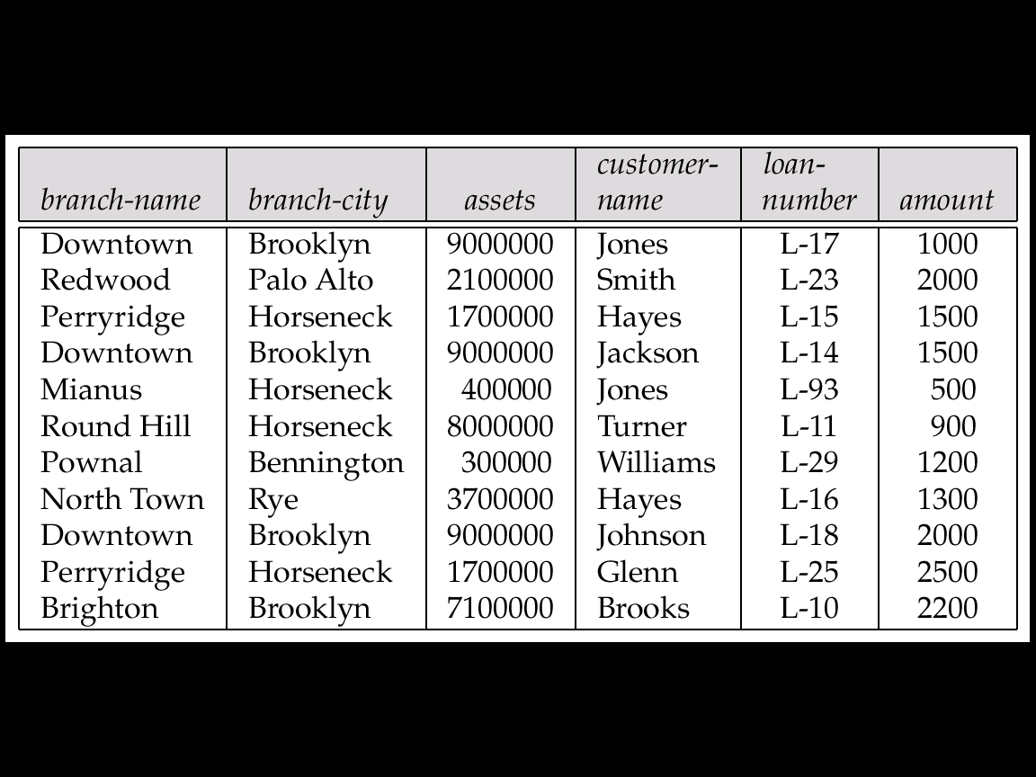
Consider the relation schema:
Lending-schema = (branch-name, branch-city, assets,
customer-name, loan-number, amount)
Redundancy:
  Data for branch-name, branch-city, assets are repeated for each loan that a branch makes
  Wastes space
  Complicates updating, introducing possibility of inconsistency of assets value
Null values
  Cannot store information about a branch if no loans exist
  Can use null values, but they are difficult to handle.

Slide 87
Decomposition
Decompose the relation schema Lending-schema into:
Branch-schema = (branch-name, branch-city,assets)
Loan-info-schema = (customer-name, loan-number,
branch-name, amount)
All attributes of an original schema (R) must appear in the decomposition (R₁, R₂):
R = R₁  R₂
Lossless-join decomposition.
For all possible relations r on schema R
r = _{R1} (r) _{R2} (r)

Slide 88
Example of Non Lossless-Join Decomposition
Decomposition of R = (A, B)
R₁ = (A) R₂ = (B)
A | B
 | 1
 | 2
 | 1
A



Slide 89
Decomposition
A functional decomposition is the process of breaking down the functions of an organization into progressively greater (finer and finer) levels of detail.
In decomposition, one function is described in greater detail by a set of other supporting functions.
The decomposition of a relation scheme R consists of replacing the relation schema by two or more relation schemas that each contain a subset of the attributes of R and together include all attributes in R.
Decomposition helps in eliminating some of the problems of bad design such as redundancy, inconsistencies and anomalies.
There are two types of decomposition :
Lossy Decomposition
Lossless Join Decomposition

Slide 90
Lossy Decomposition :
"The decompositio of relation R into R1 and R2 is lossy when the join of R1 and R2 does not yield the same relation as in R."
One of the disadvantages of decomposition into two or more relational schemes (or tables) is that some information is lost during retrieval of original relation or table.
Consider that we have table STUDENT with three attribute roll_no , sname and department.
STUDENT
ROLL NO | S NAME | DEPT
111 | PARIMAL | COMPUTER
222 | PARIMAL | ELECTRICAL

Slide 91
This relation is decomposed into two relation no_name and name_dept :1) NO NAME AND 2)NAME DEPT
ROLL NO | SNAME
111 | PARIMAL
222 | PARIMAL
SNAME | DEPT
PARIMAL | COMPUTER
PARIMAL | ELECTRICAL
In lossy decomposition ,spurious tuples are generated when a natural join is applied to the relations in the decomposition.

Slide 92
STU JOINED
ROLL NO | SNAME | DEPT
111 | PARIMAL | COMPUTER
222 | PARIMAL | ELECTRICAL
111 | PARIMAL | COMPUTER
222 | PARIMAL | ELECTRICAL
The above decomposition is a bad decomposition or Lossy decomposition.

Slide 93
Lossless Join Decomposition :
"The decompositio of relation R into R1 and R2 is lossless when the join of R1 and R2 yield the same relation as in R."
A relational table is decomposed (or factored) into two or more smaller tables, in such a way that the designer can capture the precise content of the original table by joining the decomposed parts. This is called lossless-join (or non-additive join) decomposition.
This is also refferd as non-additive decomposition.
The lossless-join decomposition is always defined with respect to a specific set F of dependencies.
Consider that we have table STUDENT with three attribute roll_no , sname and department.

Slide 94
STUDENT
ROLL NO | S NAME | DEPT
111 | PARIMAL | COMPUTER
222 | PARIMAL | ELECTRICAL
This relation is decomposed into two relation 1)Stu_name and 2)Stu_dept :
ROLL NO | SNAME
111 | PARIMAL
222 | PARIMAL
SNAME | DEPT
PARIMAL | COMPUTER
PARIMAL | ELECTRICAL
Now ,when these two relations are joined on the comman column 'roll_no' ,the resultant relation will look like stu_joined.

Slide 95
STU JOINED
ROLL NO | SNAME | DEPT
111 | PARIMAL | COMPUTER
222 | PARIMAL | ELECTRICAL
In lossless decomposition, no any spurious tuples are generated when a natural joined is applied to the relations in the decomposition.

Slide 96
DEPENDENCY
DEPENDENCY:
Dependencies in DBMS is a relation between two or more attributes. It has the following types in DBMS:
Functional Dependency
Fully-Functional Dependency
Transitive Dependency
Multivalued Dependency
Partial Dependency
Let us start with Functional Dependency:

Slide 97
Functional Dependency
If the information stored in a table can uniquely determine another information in the same table, then it is called Functional Dependency. Consider it as an association between two attributes of the same relation.
If P functionally determines Q, then
P -> Q

Slide 98
Let us see an example:
<Employee>
EmpID EmpName EmpAge
E01 Amit 28
E02 Rohit 31

Slide 99
In the above table, EmpName is functionally dependent on EmpID because EmpName can take only one value for the given value of EmpID:
EmpID ->EmpName

Slide 100
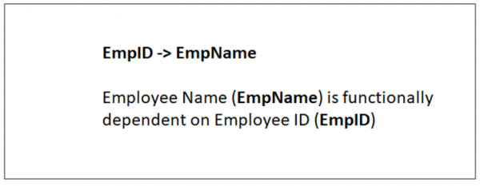
The same is displayed below:

Slide 101
Fully-functionally Dependency
An attribute is fully functional dependent on another attribute, if it is Functionally Dependent on that attribute and not on any of its proper subset.
For example, an attribute Q is fully functional dependent on another attribute P, if it is Functionally Dependent on P and not on any of the proper subset of P.

Slide 102
Let us see an example:
<ProjectCost>
ProjectID ProjectCost
001 1000
002 5000
<EmployeeProject>
EmpID ProjectID Days (spent on the project)
E099 001 320
E056 002 190

Slide 103
The above relations states:
EmpID, ProjectID, ProjectCost -> Days
However, it is not fully functional dependent.
Whereas the subset {EmpID, ProjectID} can easily determine the {Days} spent on the project by the employee.
This summarizes and gives our fully functional dependency:
{EmpID, ProjectID} -> (Days)

Slide 104
Transitive Dependency
When an indirect relationship causes functional dependency it is called Transitive Dependency.
If P -> Q and Q -> R is true, then P-> R is a transitive dependency.
Multivalued Dependency
When existence of one or more rows in a table implies one or more other rows in the same table, then the Multi-valued dependencies occur.
If a table has attributes P, Q and R, then Q and R are multi-valued facts of P.
It is represented by double arrow:
->->

Slide 105
For our example:
P->->Q
Q->->R
In the above case, Multivalued Dependency exists only if Q and R are independent attributes.
Partial Dependency
Partial Dependency occurs when a nonprime attribute is functionally dependent on part of a candidate key.
The 2nd Normal Form (2NF) eliminates the Partial Dependency. Let us see an example:

Slide 106
<StudentProject>
StudentID ProjectNo StudentNam ProjectName
S01 199 Katie GeoLocation
S02 120 Ollie Cluster Exploration

Slide 107
In the above table, we have partial dependency; let us see how:
The prime key attributes are StudentID and ProjectNo.
As stated, the non-prime attributes i.e. StudentName and ProjectName should be functionally dependent on part of a candidate key, to be Partial Dependent.
The StudentName can be determined by StudentID that makes the relation Partial Dependent.
The ProjectName can be determined by ProjectID, which that the relation Partial Dependent.

Slide 108
What is Functional Dependency
Functional dependency in DBMS, as the name suggests is a relationship between attributes of a table dependent on each other. Introduced by E. F. Codd, it helps in preventing data redundancy and gets to know about bad designs.
To understand the concept thoroughly, let us consider P is a relation with attributes A and B. Functional Dependency is represented by -> (arrow sign)
Then the following will represent the functional dependency between attributes with an arrow sign:
A -> B

Slide 109
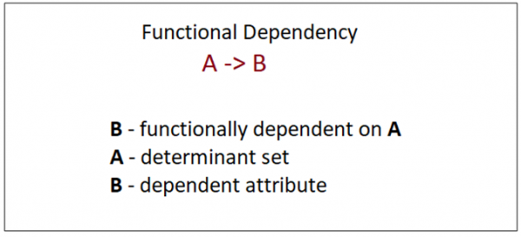
Above suggests the following:

Slide 110
Example
The following is an example that would make it easier to understand functional dependency:
We have a <Department> table with two attributes: DeptId and DeptName.
DeptId = Department ID
DeptName = Department Name
The DeptId is our primary key. Here, DeptId uniquely identifies the DeptName attribute. This is because if you want to know the department name, then at first you need to have the DeptId.
DeptId DeptName
001 Finance
002 Marketing
003 HR

Slide 111
Therefore, the above functional dependency between DeptId and DeptName can be determined as DeptId is functionally dependent on DeptName:
DeptId ->DeptName
Types of Functional Dependency
Functional Dependency has three forms:
Trivial Functional Dependency
Non-Trivial Functional Dependency
Completely Non-Trivial Functional Dependency
Let us begin with Trivial Functional Dependency:

Slide 112
Trivial Functional Dependency
It occurs when B is a subset of A in:
A ->B
Example
We are considering the same <Department> table with two attributes to understand the concept of trivial dependency.
The following is a trivial functional dependency since DeptId is a subset of DeptId and DeptName
{ DeptId, DeptName } -> Dept Id

Slide 113
Non –Trivial Functional Dependency
It occurs when B is not a subset of A in:
A ->B
Example
DeptId -> DeptName
The above is a non-trivial functional dependency since DeptName is a not a subset of DeptId

Slide 114
Completely Non - Trivial Functional Dependency
It occurs when A intersection B is null in:
A ->B
Armstrong’s Axioms Property of Functional Dependency
Armstrong’s Axioms property was developed by William Armstrong in 1974 to reason about functional dependencies.
The property suggests rules that hold true if the following are satisfied:
Transitivity
If A->B and B->C, then A->C i.e. a transitive relation.
Reflexivity
A-> B, if B is a subset of A.
Augmentation
The last rule suggests: AC->BC, if A->B

Slide 115
Inference Rule (IR):
The Armstrong's axioms are the basic inference rule.
Armstrong's axioms are used to conclude functional dependencies on a relational database.
The inference rule is a type of assertion. It can apply to a set of FD(functional dependency) to derive other FD.
Using the inference rule, we can derive additional functional dependency from the initial set.

Slide 116
Inference Rule (IR):
The Armstrong's axioms are the basic inference rule.
Armstrong's axioms are used to conclude functional dependencies on a relational database.
The inference rule is a type of assertion. It can apply to a set of FD(functional dependency) to derive other FD.
Using the inference rule, we can derive additional functional dependency from the initial set.

Slide 117
The Functional dependency has 6 types of inference rule:
1. Reflexive Rule (IR₁)
In the reflexive rule, if Y is a subset of X, then X determines Y.
If X ⊇ Y then X → Y
Example:
X = {a, b, c, d, e}
Y = {a, b, c}

Slide 118
2. Augmentation Rule (IR₂)
The augmentation is also called as a partial dependency. In augmentation, if X determines Y, then XZ determines YZ for any Z.
If X → Y then XZ → YZ
Example:
For R(ABCD), if A → B then AC → BC

Slide 119
3. Transitive Rule (IR₃)
In the transitive rule, if X determines Y and Y determine Z, then X must also determine Z.
If X → Y and Y → Z then X → Z

Slide 120
4. Union Rule (IR₄)
Union rule says, if X determines Y and X determines Z, then X must also determine Y and Z.
If X → Y and X → Z then X → YZ
Proof:
1. X → Y (given)
2. X → Z (given)
3. X → XY (using IR₂ on 1 by augmentation with X. Where XX = X)
4. XY → YZ (using IR₂ on 2 by augmentation with Y)
5. X → YZ (using IR₃ on 3 and 4)

Slide 121
5. Decomposition Rule (IR₅)
Decomposition rule is also known as project rule. It is the reverse of union rule.
This Rule says, if X determines Y and Z, then X determines Y and X determines Z separately.
If X → YZ then X → Y and X → Z
Proof:
1. X → YZ (given)
2. YZ → Y (using IR₁ Rule)
3. X → Y (using IR₃ on 1 and 2)

Slide 122
6. Pseudo transitive Rule (IR₆)
In Pseudo transitive Rule, if X determines Y and YZ determines W, then XZ determines W.
If X → Y and YZ → W then XZ → W
Proof:
1. X → Y (given)
2. YZ → W (given)
3. XZ → YZ (using IR₂ on 1 by augmenting with Z)
4. XZ → W (using IR₃ on 3 and 2)

Slide 123
Closure of Functional dependency:
The Closure Of Functional Dependency means the complete set of all possible attributes that can be functionally derived from given functional dependency using the inference rules known as Armstrong's Rules. If “F” is a functional dependency then closure of functional dependency can be denoted using “{F}⁺”.
A functional dependency A->B in a relation holds if two tuples having same value of attribute A also have same value for attribute B. For Example, in relation STUDENT shown in table 1, Functional Dependencies

Slide 124
STUD_NO->STUD_NAME, STUD_NO->STUD_PHONE hold
but
STUD_NAME->STUD_STATE, STUD_COUNTRY, STUD_AGE do not hold

Slide 125
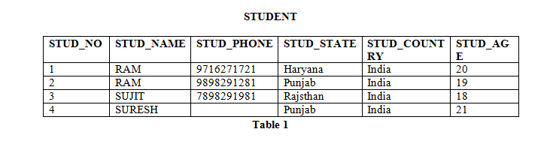

Slide 126
How to find functional dependencies for a relation?
Functional Dependencies in a relation are dependent on the domain of the relation. Consider the STUDENT relation given in Table 1.
We know that STUD_NO is unique for each student. So STUD_NO->STUD_NAME, STUD_NO->STUD_PHONE, STUD_NO->STUD_STATE, STUD_NO->STUD_COUNTRY and STUD_NO -> STUD_AGE all will be true.
Similarly, STUD_STATE->STUD_COUNTRY will be true as if two records have same STUD_STATE, they will have same STUD_COUNTRY as well.
For relation STUDENT_COURSE, COURSE_NO->COURSE_NAME will be true as two records with same COURSE_NO will have same COURSE_NAME.

Slide 127
Functional Dependency Set: Functional Dependency set or FD set of a relation is the set of all FDs present in the relation. For Example, FD set for relation STUDENT shown in table 1 is:
{ STUD_NO->STUD_NAME, STUD_NO->STUD_PHONE, STUD_NO->STUD_STATE, STUD_NO->STUD_COUNTRY,
STUD_NO -> STUD_AGE, STUD_STATE->STUD_COUNTRY }

Slide 128
Attribute Closure: Attribute closure of an attribute set can be defined as set of attributes which can be functionally determined from it.
How to find attribute closure of an attribute set?
To find attribute closure of an attribute set:
Add elements of attribute set to the result set.
. If “A” is an attribute set then closure of atrribute set can be denoted using “{A}⁺”.
Using FD set of table 1, attribute closure can be determined as:

Slide 129
(STUD_NO)+ = {STUD_NO, STUD_NAME, STUD_PHONE, STUD_STATE, STUD_COUNTRY, STUD_AGE}
(STUD_STATE)+ = {STUD_STATE, STUD_COUNTRY}

Slide 130
How to find Candidate Keys and Super Keys using Attribute Closure?
If attribute closure of an attribute set contains all attributes of relation, the attribute set will be super key of the relation.
If no subset of this attribute set can functionally determine all attributes of the relation, the set will be candidate key as well. For Example, using FD set of table 1,
(STUD_NO, STUD_NAME)+ = {STUD_NO, STUD_NAME, STUD_PHONE, STUD_STATE, STUD_COUNTRY, STUD_AGE}
(STUD_NO)+ = {STUD_NO, STUD_NAME, STUD_PHONE, STUD_STATE, STUD_COUNTRY, STUD_AGE}
(STUD_NO, STUD_NAME) will be super key but not candidate key because its subset (STUD_NO)+ is equal to all attributes of the relation. So, STUD_NO will be a candidate key.

Slide 131
EXAMPLE: Consider the relation scheme R = {E, F, G, H, I, J, K, L, M, M} and the set of functional dependencies {{E, F} -> {G}, {F} -> {I, J}, {E, H} -> {K, L}, K -> {M}, L -> {N} on R. What is the key for R? (GATE-CS-2014)
A. {E, F}
B. {E, F, H}
C. {E, F, H, K, L}
D. {E}
Answer: Finding attribute closure of all given options, we get:
{E,F}+ = {EFGIJ}
{E,F,H}+ = {EFHGIJKLMN}
{E,F,H,K,L}+ = {{EFHKLGIJMN}
{E,F,H,K,L}+ = {{EFHGIJKLMN}
{E}+ = {E}
{EFH}+ and {EFHKL}+ results in set of all attributes, but EFH is minimal. So it will be candidate key. So correct option is (B).

Slide 132
How to check whether an FD can be derived from a given FD set?
To check whether an FD A->B can be derived from an FD set F,
Find (A)+ using FD set F.
If B is subset of (A)+, then A->B is true else not true.

Slide 133
CLOSURE OF A FUNCTIONAL DEPENDENCIES:
A Closure is a set of FDs is a set of all possible FDs that can be derived from a given set of FDs.
It is also referred as a Complete set of FDs.
If F is used to donate the set of FDs for relation R, then a closure of a set of FDs implied by F is denoted by F⁺.
Let's consider the set F of functional dependencies given below:
F = {A -> B, B -> C, C -> D} from F, it is possible to derive following dependencies.
A -> A ...By using Rule-4, Self-Determination.
A -> B...Already given in F.
A -> C ...By using rule-3, Transitivity.
A -> D ...By using rule-3, Transitivity.
Now, by applyiing Rule-6 Union, it is possible to derive A⁺ -> ABCD and it can be denoted using A -> ABCD. All such type of FDs derived from each FD of F form a closure of F.
Steps to determine F⁺example:
  Determine each set of attributes x that appears as a left hand side of some FD in F.
  Determine the set x⁺ of all attributes that are dependent on x, as given in above example.
  In other words, x⁺ represents a set of attributes that are functionally determined by x based on F. And, x⁺ is called the Closure of x under F.
  All such sets of x⁺, in combine, Form a closure of F.

Slide 134
Algorithm : Determining x⁺, the closure of x under F.
Input : Let F be a set of FDs for relation R.
Steps: 1. x⁺ = x //initialize x⁺ to x
2. For each FD : y -> Z in F Do
If y ⊆ x⁺ Then //If y is contained in x⁺
x⁺ = x⁺ ∪ Z //add Z to x⁺
End If
End For
3. Return x⁺ //Return closure of x
Output : Closure x⁺ of x under F

Slide 135
CLOSURE OF A ATTRIBUTE SETS:
After finding a set of functional dependencies that are hold on a relation, the next step is to find the Super key for that relation (table).
The set of identified functional dependencies play a vital role in finding the key for the relation.
We can decide whether an attribute (or set of attributes) of any table is a key for that table or not by identifying the attribute or set of attributes’ closure.
If A is an attribute, (or set of attributes) then its attribute closure is denoted as A+.
Algorithm
result := A;
while (changes to result) do
for each functional dependency B → C in F do
begin
if B ⊆ result then result := result ∪ C;
end
Let us discuss this algorithm with an example;
Assume a relation schema R = (A, B, C) with the set of functional dependencies F = {A → B, B → C}. Now, we can find the attribute closure of attribute A as follows;
Step 1: We start with the attribute in question as the initial result. Hence, result = A.
Step 2: Take the first FD A → B. Its left hand side (i.e, A) is in the result, hence the right hand side can be included with the result. This lead to result = AB.
Step 3: Take the second FD B → C. Its left hand side (i.e, B) is in the result (or subset of result), hence the right hand side can be included with the result. Now, result = ABC.
We have no more attributes. Hence the algorithm exits. As the result, A⁺ includes all the attributes of relation R. now we would say A⁺ is ABC. And, A is one of the keys of the relation R.

Slide 136
MINIMAL FUNCTIONAL DEPENDENCY
Whenever a user updates the database, the system must check whether any of the functional dependencies are getting violated in this process.
If there is a violation of dependencies in the new database state, the system must roll back.
Working with a huge set of functional dependencies can cause unnecessary added computational time.
This is where the canonical cover comes into play.
A canonical cover of a set of functional dependencies F is a simplified set of functional dependencies that has the same closure as the original set F.
Extraneous attributes: An attribute of a functional dependency is said to be extraneous if we can remove it without changing the closure of the set of functional dependencies.

Slide 137
Canonical cover: A canonical cover F_{c} of a set of functional dependencies F such that ALL the following properties are satisfied:
F logically implies all dependencies in F_{c}.
F_{c} logically implies all dependencies in F.
No functional dependency in F_{c} contains an extraneous attribute.
Each left side of a functional dependency in F_{c} is unique. That is, there are no two dependencies \alpha_{1} \rightarrow \beta_{1} and \alpha_{2} \rightarrow \beta_{2} in such that \alpha_{1} \rightarrow \alpha_{2}.
That is , there are no two dependencies such as ,
1)alpha1 -> beta1,
and
2)alpha2-> beta2,
Such that
alpha1-> alpha2

Slide 138
Algorithm to compute canonical cover of set F:
  Step 1. Use the union rule to replace any dependencies in \alpha_{1} \rightarrow \beta_{1} and \alpha_{1} \rightarrow \beta_{2} with \alpha_{1} \rightarrow \beta_{1}\beta_{2}.
  That is
1)alpha1 -> beta1,and 2)alpha2-> beta2,with
alpha1-> beta1Ubeta2
  Step 2. Find a functional dependency \alpha \rightarrow \beta with an extraneous attribute either in \alpha or in \beta.
  Step 3. If an extraneous attribute is found, delete it from \alpha \rightarrow \beta. until F does not change

Slide 139
NORMALIZATION
Normalization is a process of organizing the data in database to avoid data redundancy, insertion anomaly, update anomaly & deletion anomaly.
Normalization is the process of organizing the data in the database.
Normalization is used to minimize the redundancy from a relation or set of relations. It is also used to eliminate the undesirable characteristics like Insertion, Update and Deletion Anomalies.
Normalization divides the larger table into the smaller table and links them using relationship.
The normal form is used to reduce redundancy from the database table.

Slide 140
Normalization is used for mainly two purposes,
Eliminating redundant(useless) data.
Ensuring data dependencies make sense i.e data is logically stored.

Slide 141
TYPES OF NORMAL FORMS
1.1NF (FIRST NORMAL FORM)
2.2NF (SECOND NORMAL FORM)
3.3NF (THIRD NORMAL FORM)
4.BCNF(BOYCE CODD NORMAL FORM)
5. 4NF (FOURTH NORMAL FORM)
6. 5NF (FIFTH NORMAL FORM)

Slide 142
Example tables:
Course code | Course venue | Instructor Name | Instructor’s phone number
CS101 | Lecture Hall 20 | Prof. George | +1 6514821924
CS152 | Lecture Hall 21 | Prof. Atkins | +1 6519272918
CS154 | CS Auditorium | Prof. George | +1 6514821924

Slide 143
Here, the data basically stores the course code, course venue, instructor name, and instructor’s phone number. At first, this design seems to be good. However, issues start to develop once we need to modify information. For instance, suppose, if Prof. George changed his mobile number. In such a situation, we will have to make edits in 2 places. What if someone just edited the mobile number against CS101, but forgot to edit it for CS154? This will lead to stale/wrong information in the database.
This problem, however, can be easily tackled by dividing our table into 2 simpler tables:
Table 1 (Instructor):
Instructor ID
Instructor Name
Instructor mobile number
Table 2 (Course):
Course code
Course venue
Instructor ID
Now, our data will look like the following:

Slide 144
):
Table 1 (Instructor
Insturctor's ID | Instructor's name | Instructor's number
1 | Prof. George | +1 6514821924
2 | Prof. Atkins | +1 6519272918

Slide 145
Table 2 (Course)
Course code | Course venue | Instructor ID
CS101 | Lecture Hall 20 | 1
CS152 | Lecture Hall 21 | 2
CS154 | CS Auditorium | 1

Slide 146
Basically, we store the instructors separately and in the course table, we do not store the entire data of the instructor. We rather store the ID of the instructor. Now, if someone wants to know the mobile number of the instructor, he/she can simply look up the instructor table. Also, if we were to change the mobile number of Prof. George, it can be done in exactly one place. This avoids the stale/wrong data problem.
Further, if you observe, the mobile number now need not be stored 2 times. We have stored it at just 1 place. This also saves storage. This may not be obvious in the above simple example. However, think about the case when there are hundreds of courses and instructors and for each instructor, we have to store not just the mobile number, but also other details like office address, email address, specialization, availability, etc. In such a situation, replicating so much data will increase the storage requirement unnecessarily.

Slide 147
First Normal Form (1NF)
For a table to be in the First Normal Form, it should follow the following 4 rules:
It should only have single(atomic) valued attributes/columns.
Values stored in a column should be of the same domain
All the columns in a table should have unique names.
And the order in which data is stored, does not matter.

Slide 148
Instructor's name | Course code
Prof. George | (CS101, CS154)
Prof. Atkins | (CS152)

Slide 149
Here, the issue is that in the first row, we are storing 2 courses against Prof. George. This isn’t the optimal way since that’s now how SQL databases are designed to be used. A better method would be to store the courses separately. For instance:

Slide 150
Instructor's name | Course code
Prof. George | CS101
Prof. George | CS154
Prof. Atkins | CS152

Slide 151
This way, if we want to edit some information related to CS101, we do not have to touch the data corresponding to CS154. Also, observe that each row stores unique information. There is no repetition. This is the First Normal Form

Slide 152
Second Normal Form (2NF)
For a table to be in the Second Normal Form,
It should be in the First Normal form.
And, it should not have Partial Dependency.
The first point is obviously straightforward since we just studied 1NF. Let us understand the first point - 1 column primary key. Well, a primary key is a set of columns that uniquely identifies a row. Basically, no 2 rows have the same primary keys. Let us take an example.

Slide 153
Course code | Course venue | Instructor Name | Instructor’s phone number
CS101 | Lecture Hall 20 | Prof. George | +1 6514821924
CS152 | Lecture Hall 21 | Prof. Atkins | +1 6519272918
CS154 | CS Auditorium | Prof. George | +1 6514821924

Slide 154
Here, in this table, the course code is unique. So, that becomes our primary key. Let us take another example of storing student enrollment in various courses. Each student may enroll in multiple courses. Similarly, each course may have multiple enrollments. A sample table may look like this (student name and course code):
Student name | Course code
Rahul | CS152
Rajat | CS101
Rahul | CS154
Raman | CS101

Slide 155
Here, the first column is the student name and the second column is the course taken by the student. Clearly, the student name column isn’t unique as we can see that there are 2 entries corresponding to the name ‘Rahul’ in row 1 and row 3. Similarly, the course code column is not unique as we can see that there are 2 entries corresponding to course code CS101 in row 2 and row 4. However, the tuple (student name, course code) is unique since a student cannot enroll in the same course more than once. So, these 2 columns when combined form the primary key for the database.
As per the second normal form definition, our enrollment table above isn’t in the second normal form. To achieve the same (1NF to 2NF), we can rather break it into 2 tables:

Slide 156
Students table
Student name | Enrolment number
Rahul | 1
Rajat | 2
Raman | 3
Here the second column is unique and it indicates the enrollment number for the student. Clearly, the enrollment number is unique. Now, we can attach each of these enrollment numbers with course codes.

Slide 157
Courses:
Course code | Enrolment number
CS101 | 2
CS101 | 3
CS152 | 1
CS154 | 1
These 2 tables together provide us with the exact same information as our original table.

Slide 158
:
Third Normal Form (3NF)
A table is said to be in the Third Normal Form when,
It is in the Second Normal form.
And, it doesn't have Transitive Dependency.
Column A is said to be functionally dependent on column B if changing the value of A may require a change in the value of B. As an example, consider the following table

Slide 159
Course code | Course venue | Instructor's name | Department
MA214 | Lecture Hall 18 | Prof. George | CS Department
ME112 | Auditorium building | Prof. John | Electronics Department

Slide 160
Here, the department column is dependent on the professor name column. This is because if in a particular row, we change the name of the professor, we will also have to change the department value. As an example, suppose MA214 is now taken by Prof. Ronald who happens to be from the Mathematics department, the table will look like this:

Slide 161
Course code | Course venue | Instructor's name | Department
MA214 | Lecture Hall 18 | Prof. Ronald | Mathematics Department
ME112 | Auditorium building | Prof. John | Electronics Department

Slide 162
Here, when we changed the name of the professor, we also had to change the department column. This is not desirable since someone who is updating the database may remember to change the name of the professor, but may forget updating the department value. This can cause inconsistency in the database.
Third normal form avoids this by breaking this into separate tables:

Slide 163
Course code | Course venue | Instructor's ID
MA214 | Lecture Hall 18 | 1
ME112 | Auditorium building, | 2

Slide 164
Here, the third column is the ID of the professor who’s taking the course.
Instructor's ID | Instructor's Name | Department
1 | Prof. Ronald | Mathematics Department
2 | Prof. John | Electronics Department

Slide 165
Here, in the above table, we store the details of the professor against his/her ID. This way, whenever we want to reference the professor somewhere, we don’t have to put the other details of the professor in that table again. We can simply use the ID.

Slide 166
Boyce and Codd Normal Form (BCNF)
Boyce and Codd Normal Form is a higher version of the Third Normal form. This form deals with certain type of anomaly that is not handled by 3NF. A 3NF table which does not have multiple overlapping candidate keys is said to be in BCNF. For a table to be in BCNF, following conditions must be satisfied:
R must be in 3rd Normal Form
and, for each functional dependency ( X → Y ), X should be a super Key and it’s a trivial functional dependency.
Let us first understand what a superkey means. To understand BCNF in DBMS, consider the following BCNF example table:

Slide 167
Course code | Course venue | Instructor Name | Instructor’s phone number
CS101 | Lecture Hall 20 | Prof. George | +1 6514821924
CS152 | Lecture Hall 21 | Prof. Atkins | +1 6519272918
CS154 | CS Auditorium | Prof. George | +1 6514821924

Slide 168
Here, the first column (course code) is unique across various rows. So, it is a superkey. Consider the combination of columns (course code, professor name). It is also unique across various rows. So, it is also a superkey. A superkey is basically a set of columns such that the value of that set of columns is unique across various rows. That is, no 2 rows have the same set of values for those columns. Some of the superkeys for the table above are:
Course code
Course code, professor name
Course code, professor mobile number

Slide 169
A superkey whose size (number of columns) is the smallest is called as a candidate key. For instance, the first superkey above has just 1 column. The second one and the last one have 2 columns. So, the first superkey (Course code) is a candidate key.
Boyce-Codd Normal Form says that if there is a functional dependency X→ Y, then either X is a superkey or it is a trivial functional dependency. A trivial functional dependency means that all columns of Y are contained in the columns of X. For instance, (course code, professor name) → (course code) is a trivial functional dependency because when we know the value of course code and professor name, we do know the value of course code and so, the dependency becomes trivial.

Slide 170
Fourth Normal Form (4NF)
A table is said to be in the Fourth Normal Form when,
It is in the Boyce-Codd Normal Form.
And, it doesn't have Multi-Valued Dependency.
Fifth Normal Form(5NF)
A relation is in 5NF if it is in 4NF and not contains any join dependency and joining should be lossless.

